Slide 1


SPFx Tech Tutorial and Demo
Tesfaye Gari
Tesfaye.gari@gmail.com
240-547-6851

Slide 2
Agenda
What is spfx
01
Benefit of spfx
02
How to setup spfx (technologies used)
03
Demo
04

Slide 3
What is SPFx
SPFx (short for SharePoint Framework) is a “page and web part model that provides full support for client-side SharePoint development, easy integration with SharePoint data, and support for open-source tooling”

Slide 4
Benefits of Using SPFx
Total absence of iframes. SPFx operates in the user’s browser
SPFx enables faster rendering in the browser and normal page DOM
All the controls are responsive, and they are rendered in the normal DOM
SPFx is framework agnostic. You can use any framework that you like. React, Angular, Knockout - anything goes
SPFx allows the use of open-source development tools like npm, TypeScript, Yeoman, webpack and Gulp
SPFx works with both classic pages and modern SharePoint pages
Development in SPFx is safe and secure
Controlled visibility - with SPFx, devs can give viewing option to the webpart in the App Catalog of the site contents to anyone they like
Earlier knowledge of CSOM comes in handy here - the data models are not changed, and everything is completely transferable
SPFx supports mobile views of SharePoint Online sites, Supported by SP 2016, 2019 and SP online

Slide 5
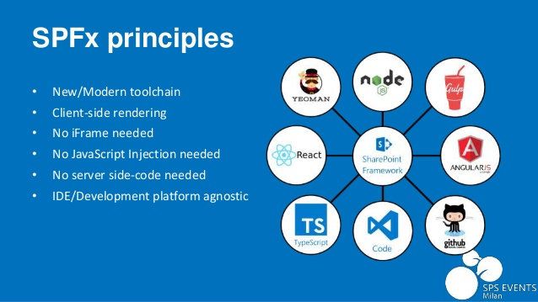
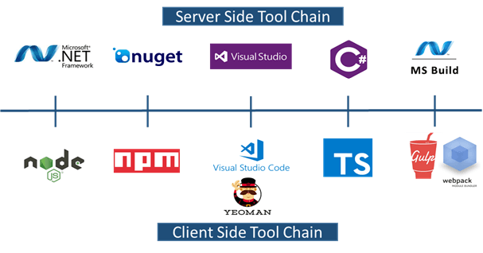
Setup and Technologies

Slide 6
Demo

Slide 7
Question and answer

